Slide 1
Data Visualization
216H03L602
Module 1

Slide 2
Introduction data visualization (5)
Introduction to data visualization and it’s needs. Data analysis lifecycle. A Visual Revolution, Various types of visualization with its best practices. From Visualization to Visual Data Storytelling: An Evolution, From Visual to Story: Bridging the Gap Data Fundamentals, Collecting data, Preparing Data Gestalt Principles Cleaning Data using Excel

Slide 3
Books
Lindy Ryan, “Visual Data Storytelling with Tableau”, Pearson Education First edition, 2018
Cole Nussbaumer Knaflic, “Storytelling with Data”, Wiley First edition,
2015
Alberto Ferrari and Marco Russo, “Introducing Microsoft Power BI”, Microsoft Press, 2016

Slide 4
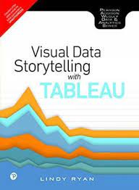
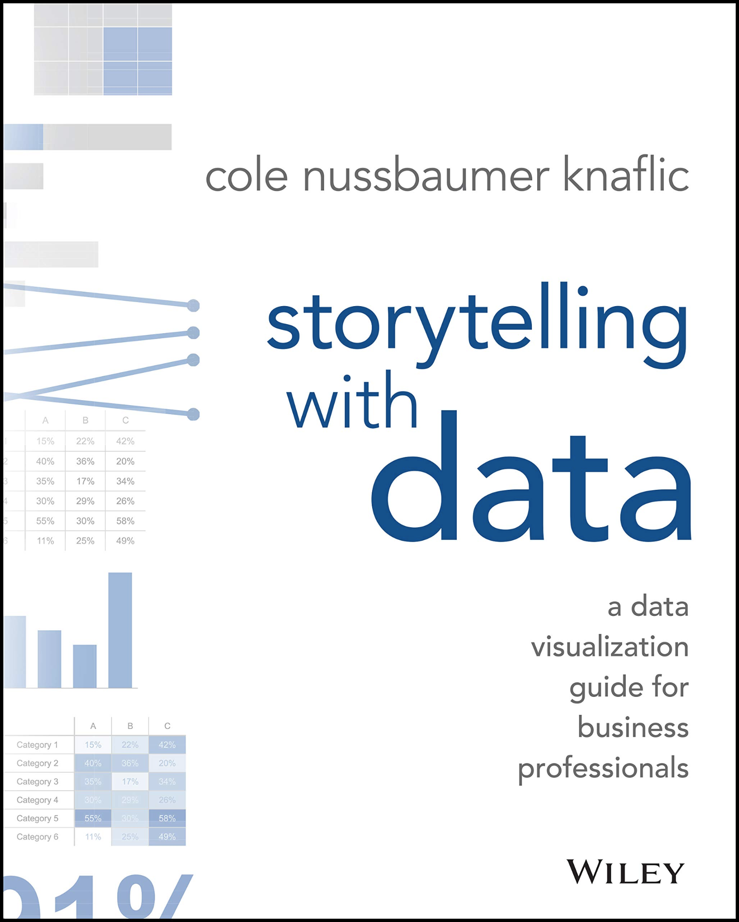


Slide 5
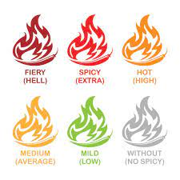
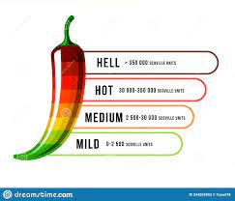
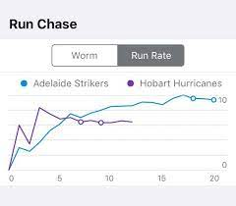
Data Visualization
A picture speaks more than 1000 words
Colors attracts more attention
Non-verbal communication can influence human mind subtly
Universal language has no bar
Vegetarian
Non- Vegetarian

Slide 6
Introduction to data visualization and it’s need
Data visualization:
A graphic representation that expresses the significance of data
Reveals insights and patterns that are not immediately visible in the raw data
An art through which information, numbers, and measurements can be made easy to understand and manipulate making the information useful
Primary goal is to communicate information clearly and effectively through graphical means
Pictorial format representing some form of collected data which would help in making decision or navigation

Slide 7
Introduction to data visualization and it’s need
Data visualization:
65% of the audience is visual learner
Easy to retain
80% of what we see compared to 20% of what we read 0% of what we hear
It takes just 1/10 seconds for brain to process as an image
Pictures would help in
Decision making
Uncovering patterns and trends
Presenting arguments or telling story

Slide 8
Introduction to data visualization and it’s need
Data visualization:
65% of the audience is visual learner
Tools for Visual Learners
Use mind pictures or mind maps
Take notes
Use "clue" words for recalling
Use colored highlighters to color code texts and notes
Use maps, charts, diagrams, and lists
Watch audiovisuals
Take photographs
Use study cards or flashcards
Use notebooks
Watch instructor's mouth and face
Use visual chains or mnemonics
Watch TV
See parts of words
Write down directions

Slide 9
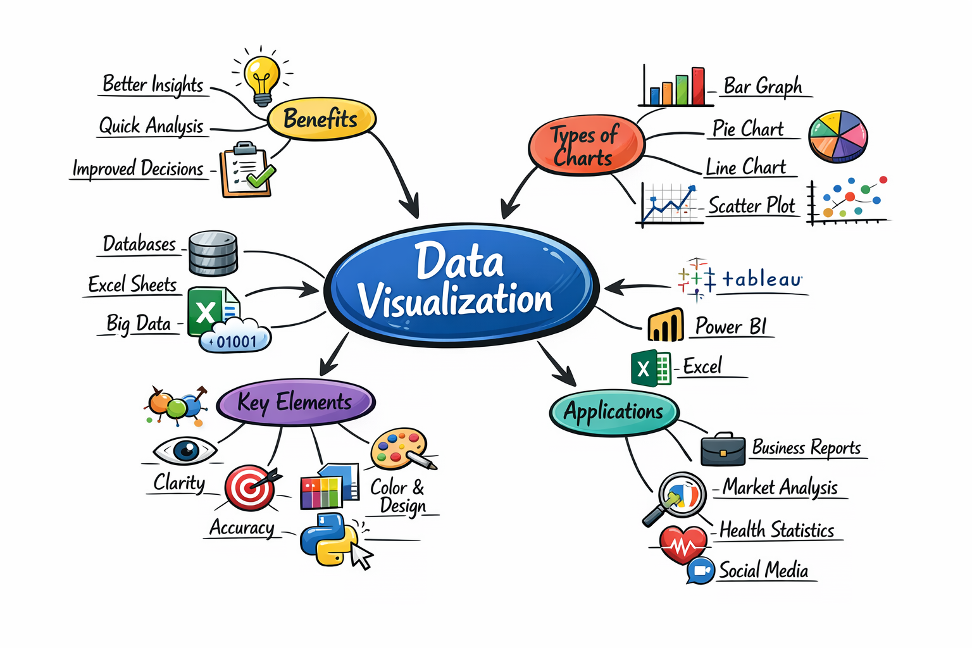
Mind Map of DV

Slide 10
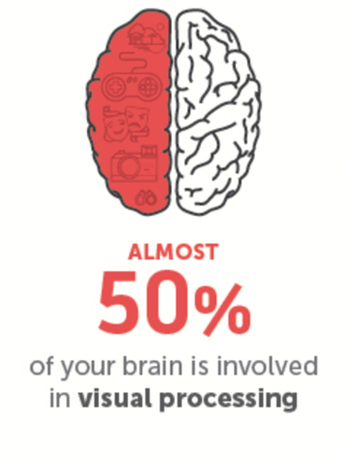
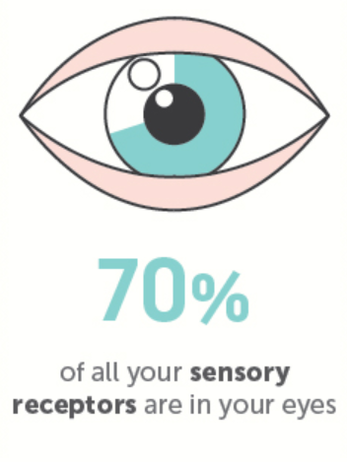

Introduction to data visualization and it’s need
Data visualization:
Easy to retain
80% of what we see compared to 20% of what we read 10% of what we hear

Slide 11
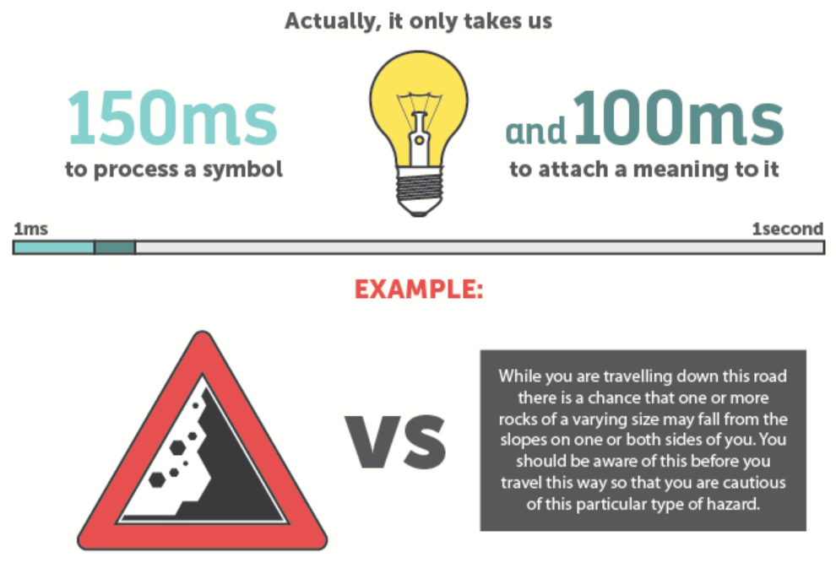
Introduction to data visualization and it’s need
Data visualization:
Easy to retain
80% of what we see compared to 20% of what we read 10% of what we hear

Slide 12

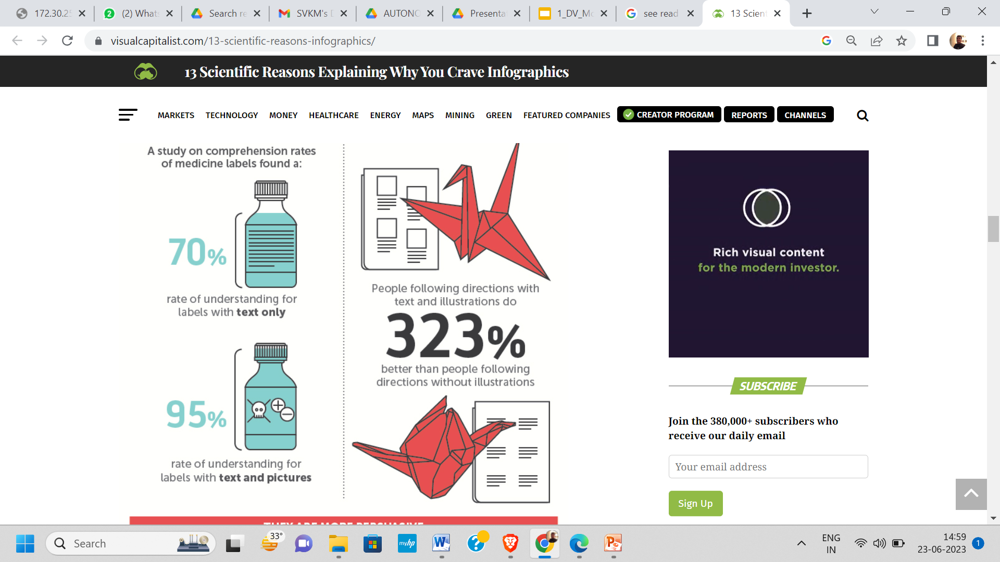
Introduction to data visualization and it’s need
Data visualization:
Easy to retain
80% of what we see compared to 20% of what we read 10% of what we hear

Slide 13
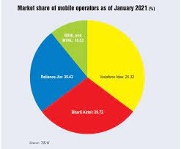
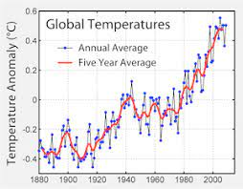
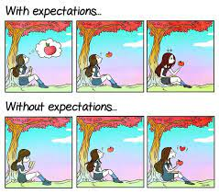
Introduction to data visualization and it’s need
Data visualization:
It takes just 1/10 seconds for brain to process as an image
Pictures would help in
Decision making
Uncovering patterns and trends
Presenting arguments or telling story

Slide 14
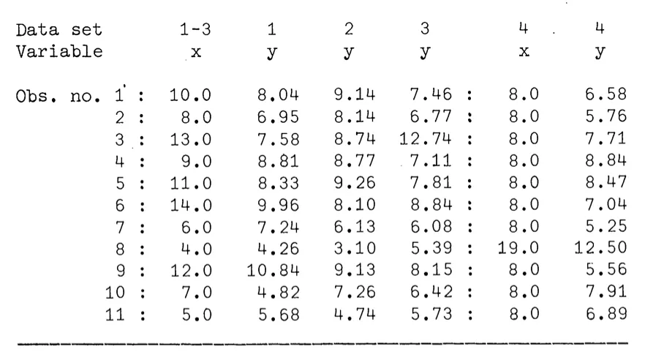
Importance of data visualisation

Slide 15
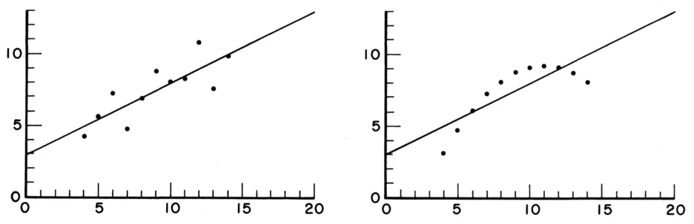
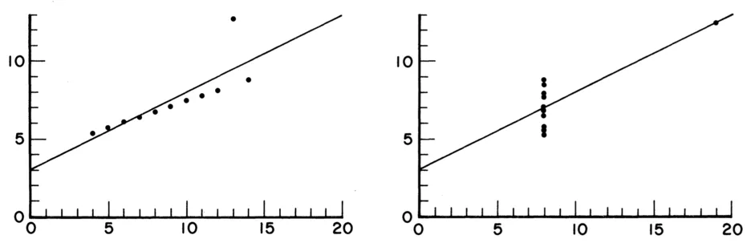
Same data presented in graphical form

Slide 16
Visualization steps
Data acquisition
Data generated/ collected
Data processed
Data mapped to visual primitive; (color, geometry etc.)
Images generated
Data enhancement
Visualization mapping
Rendering (ND to 2D)

Slide 17
Types of Visulaisation
Scientific Visualisation SciVis:
used for the clarification of well-known phenomena
Information Visualisation InfoVis:
used for searching for interesting phenomena

Slide 18
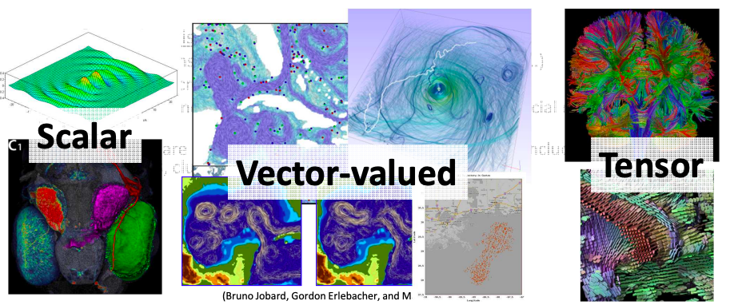
SciVis vs. InfoVis
• Scientific visualization is mostly concerned with: –
Data defined in physical space, i.e. spatio-temporal data (2~4 dimensions)
Data describes continuous events in continuous space, however, the representation is discrete (i.e. sampled data)
Examples include simulation and measurement data from physics, chemistry, geo-science, medical-biological, climate, oceanography, energy, ……
Features are well-defined

Slide 19
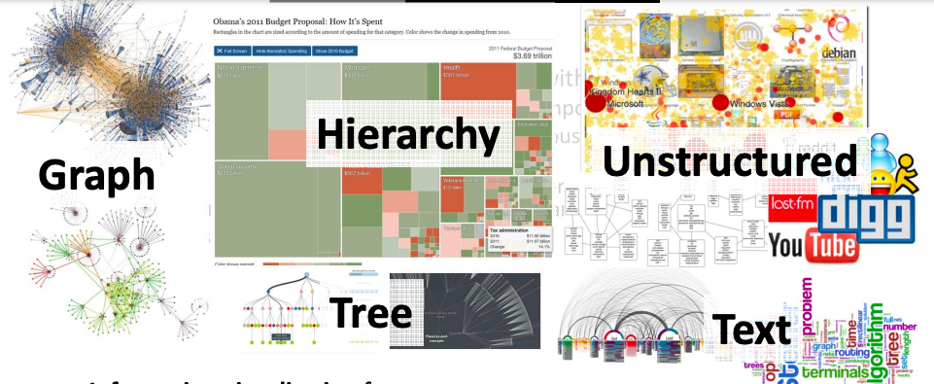
SciVis vs. InfoVis
• Information visualization focuses on:
high-dimensional (>>4), abstract data (i.e. tree, graphs, hierarchy, …)
Data is discrete in the nature
Examples include financial, marketing, HR, statistical, social media, political, …...
Feature are not well-defined, the typical analysis tasks including finding patterns, clusters, voids, outliers

Slide 20
Need of Data Visualization
Data visualization helps to tell stories by curating data into a form easier to understand, highlighting the trends and outliers.
Analysing the Data in a Better way
Data visualization can help by delivering data in the most efficient way possible.
Data visualization takes the raw data, models it, and delivers the data so that conclusions can be reached.
Faster Decision Making
Data visualization uses visual data to communicate information in a manner that is universal, fast, and effective.
Making Sense of Complicated Data
Data visualization positively affects an organization’s decision-making process with interactive visual representations of data.

Slide 21
Class participation
Google form to collect Data
Sample Responses (Excel format)
Sample Responses Graphical form

Slide 22
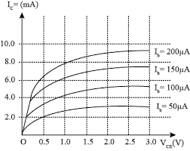
Need of Data Visualization
Businesses can now recognize patterns more quickly because they can interpret data in graphical or pictorial forms.
Correlations in Relationships: Without data visualization, it is challenging to identify the correlations between the relationship of independent variables. Make better business decisions by making sense of those independent variables.

Slide 23
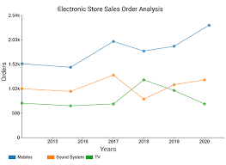
Need of Data Visualization
Businesses can now recognize patterns more quickly because they can interpret data in graphical or pictorial forms.
Trends Over Time: an obvious and one of the most valuable applications use of data visualization It’s impossible to make predictions without having the necessary information from the past and present. Trends over time tell where we were and where we can potentially go.

Slide 24
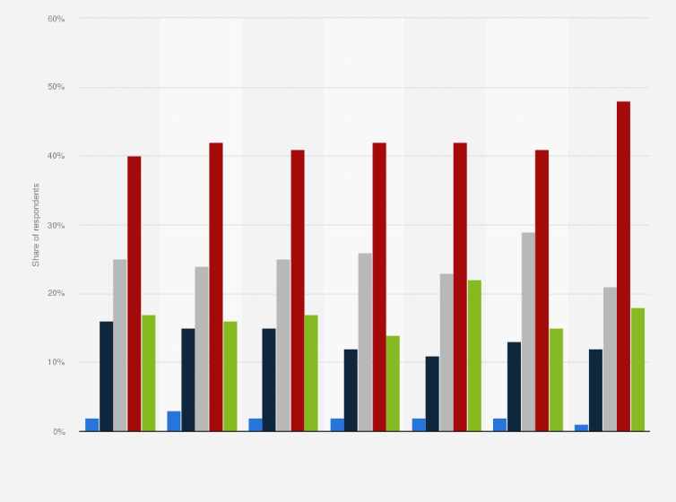
Need of Data Visualization
Businesses can now recognize patterns more quickly because they can interpret data in graphical or pictorial forms.
Frequency: Closely related to trends over time is frequency. By examining the rate, or how often, customers purchase and when they buy gives a better feel for how potential new customers might act and react to different marketing and customer acquisition strategies.

Slide 25
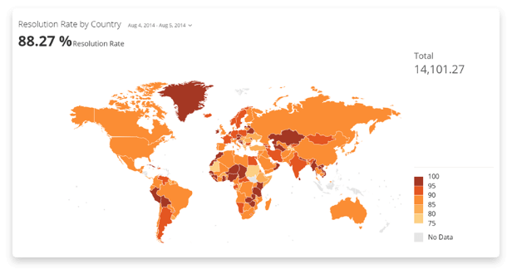
Need of Data Visualization
Businesses can now recognize patterns more quickly because they can interpret data in graphical or pictorial forms.
Examining the Market: Data visualization takes the information from different markets to give you insights into which audiences to focus your attention on and which ones to stay away from. We get a clearer picture of the opportunities within those markets by displaying this data on various charts and graphs.

Slide 26
Need of Data Visualization
Businesses can now recognize patterns more quickly because they can interpret data in graphical or pictorial forms.
Correlations in Relationships:
Trends Over Time:
Frequency:
Examining the Market:

Slide 27
Need of Data Visualization
Risk and Reward: Looking at value and risk metrics requires expertise because, without data visualization, we must interpret complicated spreadsheets and numbers. Once information is visualized, we can then pinpoint areas that may or may not require action.
Reacting to the Market: The ability to obtain information quickly and easily with data displayed clearly on a functional dashboard allows businesses to act and respond to findings swiftly and helps to avoid making mistakes.
Data visualization helps to tell stories by curating data into a form easier to understand, highlighting the trends and outliers
A good visualization tells a story, removing the noise from data and highlighting the useful information
Effective data visualization is a delicate balancing act between form and function
The most stunning visualization could utterly fail at conveying the right message or it could speak volumes
The data and the visuals need to work together

Slide 28
Data Analysis Lifecycle
Objective
Understanding the data
Data Visualisation
Data Analytics
Data Cleaning & Transformation
Data Enhancing

Slide 29
Data Analysis Lifecycle
Objective
Identify WHY is the data collected.
The purpose of data collection decides WHAT to collect and HOW and from WHOM and to WHOM will that be presented
Understanding the Data
Know WHAT is collected
Data Cleaning & Data Transformation
Remove the UNWANTED data (noise) which may be irrelevant
Convert data from one form to another if needed
Data Enhancing
Identify the distinguishing features of the data and highlight them
Data Analytics
Model the data for presentation
Interpret the data
Data Visualisation
Present the data to the end user in the way (s)he will use to gain

Slide 30
Data Analytics Lifecycle
Data Discovery and Formation
Identify data’s purpose and how to achieve it
Consists of mapping out the potential use and requirement of data,
Source of information; Where the information is coming from
What story you want your data to convey
How your organization benefits from the incoming data
Focus on enterprise requirements related to data, rather than data itself
Assessing the tools and systems that are necessary to read, organize, and process all the incoming data.
The data science team learn and investigate the problem.
Develop context and understanding.
Come to know about data sources needed and available for the project.
The team formulates initial hypothesis that can be later tested with data

Slide 31
Data Analytics Lifecycle
Data Discovery and Formation
Data Preparation
Steps to explore, preprocess, and condition data prior to modeling and analysis.
Execute, load, and transform the data
Tasks could be performed multiple times and not in predefined order
Several tools commonly used for this phase are – Hadoop, Alpine Miner, Open Refine, etc.
Model Planning
Data is explored to learn about relationships between variables and subsequently, selects key variables and the most suitable models.
Data science team develop data sets for training, testing, and production purposes
Team builds and executes models based on the work done in the model planning phase.
Several tools commonly used for this phase are – Matlab, STASTICA.

Slide 32
Data Analytics Lifecycle
Data Discovery and Formation
Data Preparation
Model Planning
Model Building
Team develops datasets for testing, training, and production purposes.
Team also considers whether its existing tools will suffice for running the models or if they need more robust environment for executing models.
Free or open-source tools – Rand PL/R, Octave, WEKA.
Commercial tools – Matlab , STASTICA.
Communication of Results
After executing model team need to compare outcomes of modeling to criteria established for success and failure.
Team considers how best to articulate findings and outcomes to various team members and stakeholders, taking into account warning, assumptions.
Team should identify key findings, quantify business value, and develop narrative to summarize and convey findings to stakeholders.

Slide 33
Data Analytics Lifecycle
Data Discovery and Formation
Data Preparation
Model Planning
Model Building
Communication of Results
Optimization
The team communicates benefits of project more broadly and sets up pilot project to deploy work in controlled way before broadening the work to full enterprise of users.
This approach enables team to learn about performance and related constraints of the model in production environment on small scale , and make adjustments before full deployment.
The team delivers final reports, briefings, codes.
Free or open source tools – Octave, WEKA, SQL, MADlib.

Slide 34
Visual Revolution, Various types of visualization with its best practices.
A 'Visual Revolution' is changing the way we communicate
Use all kind of visuals - images, graphics, videos and animations to create emotional connections
Make sure your content is unique so that people will remember for longer duration, creating impact
Create visuals that are useful to customers, or other supporters
Invite other people to share their images to encourage interaction and engagement
Include short captions with your visuals to give context or include a call to action that asks people to take the next step

Slide 35
Visualization best practices
With explosion in volume and complexity of data generated, use of data visualitzation becomes essential
Human processes visual information better than tables, numbers, and text
Converting into graphs and charts data is transformed into easy-to -understand form

Slide 36
Data Types
Numeric / alpha numeric / Images/ Audio
Numeric Data:
Categories based on measurement scale:
Nominal Scale (qualitative variable or categorical variable). NO arithmetic operations are possible
e.g blood group : A, B, AB & O
Ordinal Scale: (values are captured from an ordered set). Order is fixed and no arithmetic operations can be performed
e.g. review ratings on a Likert scale (1-5, 5 being highest )
Interval Scale: (Data points taken from a fixed interval set) Cannot perform ratios on interval scale data
e.g. 50 degree C is not twice hot as 25 degree C
Ratio Scale: Arithmetic operations are possible
Product sales, salary

Slide 37
Data Types & Operations
Data Type | Operations
Nominal | Can only check if the values are same or not (= = or !=)
Ordinal | Can compare ( ==, != , < , >)
Interval | Can measure distance or span with operations ( ==, !=, < , > ,-)
Ratio | Can measure proportions with operations (== ,!=, < , > ,+, - ,%)

Slide 38
From Visualization to Visual Data Storytelling: An Evolution
Data visualization will depend on statistical understanding of the data, its context and to measure it to avoid false analysis and skewed decision making
Human visual cognition system demands a way to encode numbers with meaning by relying on colours and shapes to support interpretation
Data visualization is the best way to see and understand huge, most diverse data

Slide 39
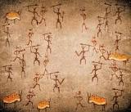
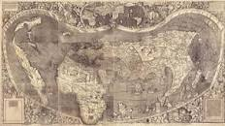

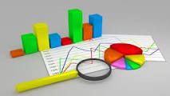
From Visualization to Visual Data Storytelling An Evolution
Data visualization
Cave drawings
Early Maps
Modern Maps
Statistical graphs

Slide 40
From Visualization to Visual Data Storytelling An Evolution
Data visualization aided by:
Advancement in visual design
Cognitive science
Technology and
Business intelligence
An emerging new approach to storytelling attempts to combine data with graphics and tell the world’s stories through the power of information visualization.

Slide 41
From Visualization to Visual Data Storytelling: An Evolution
Evidence of the cognitive effects of storytelling in neurology is it’s a central way that we learn, remember, and communicate information
Important goal of visual story is to prepare business decision makers to leave a data presentation with a story in their head that helps them both to remember your message and take action on it
Data stories provide tool to communicate information in ways the facts and figures alone can’t

Slide 42
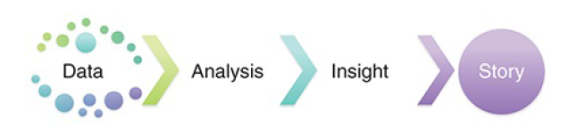
From Visualization to Visual Data Storytelling: An Evolution
Storytelling Process

Slide 43
From Visual to Story: Bridging the Gap
Data Storytelling is needed as amount of data is growing day-by-day
Steps
Create Data
Collect Data
Clean/ Prepare Data
Present Data (Visualization)
Storytelling (Communication)

Slide 44
Data Visualization V/s Data Storytelling
Data visualization: the practice of graphically representing data to help people see and understand patterns, insights, and other discoveries hidden inside information
Data storytelling: translate seeing into meaning by weaving a narrative around the data to answer questions and support decision making

Slide 45
Digital Storytelling
Process of using Digital Technology to communicate to aid taking decision making
Process of Storytelling:
Use of media
Text,
Visuals
Music
Video
Voice
To reach to wider audience in more convincing way

Slide 46

Digital Storytelling
Data:
How to prepare pasta :
Ingredients
Process/ Procedure
Visualisation:
Use images to express
Presentation:
Use presentation to create long lasting impression

Slide 47
Module 1.2
Data Fundamentals
Collecting data
Preparing Data

Slide 48
Data Fundamentals
Data Fundamental:
Primary Data:
Collected afresh
Need to validate the process and collected information
Secondary Data:
Collected by some one
Validity/ relevance may be checked

Slide 49
Collecting data
Collecting data:
Primary Data:
Survey
Descriptive research
Observation: systematic viewing
Direct Communication
Personal Interviews
Secondary Data:
Download from reliable source

Slide 50
Collecting data
Primary Data:
Advantages
Unbiased data
Fresh Information
Relevant information could be captured
Limitations:
Time consuming
Costly
Limited scope

Slide 51
Data Fundamentals, Collecting data, Preparing Data
Collecting Primary data:
Types of observation:
Structured:
Standard conditions
Well prepared
Forms/ formats
Checklist
Unstructured:
Without much preparation

Slide 52
Module 1.3
Gestalt Principles of Visual Perception

Slide 53
Gestalt Principles of Visual Perception
Human brain perceive objects as well-organized patterns rather than separate components.
“The whole is greater than the sum of it’s parts.”
Based on the concept of “grouping”.

Slide 54
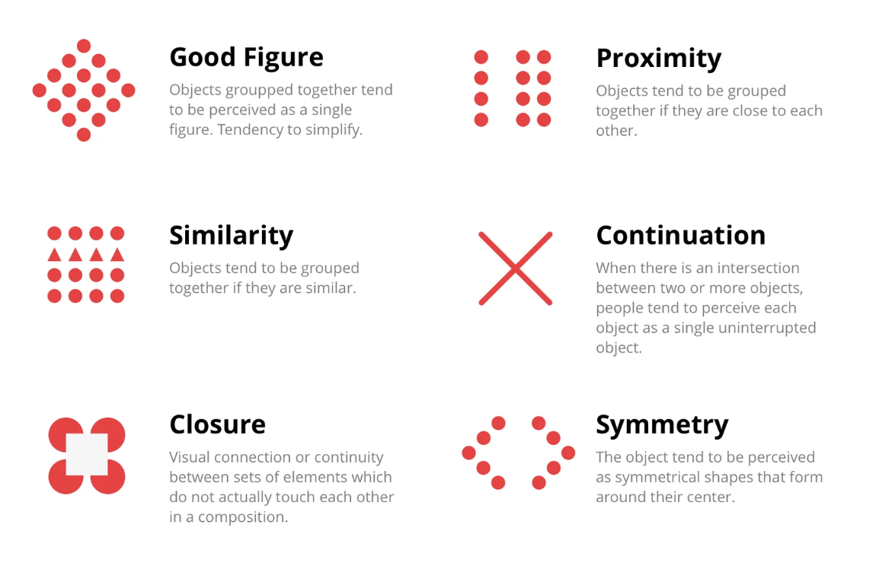
Gestalt Principles of Visual Perception

Slide 55

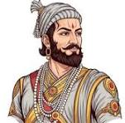
Gestalt Principles of Visual Perception
We impose visual organization on stimuli

Slide 56

Gestalt Principles of Visual Perception
Illusory Contours:
Visual connection or continuity between sets of elements which do not actually touch each other in a composition
The Kanisza triangle as figure-ground illusory contours

Slide 57
Gestalt Principles of Visual Perception
Three Main Principles:
Grouping (proximity, similarity, continuity, closure)
Goodness of figures
Figure/ground relationships

Slide 58

Grouping: Law of Proximity
Objects close to each other are perceived as a group

Slide 59
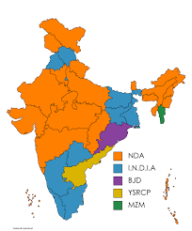
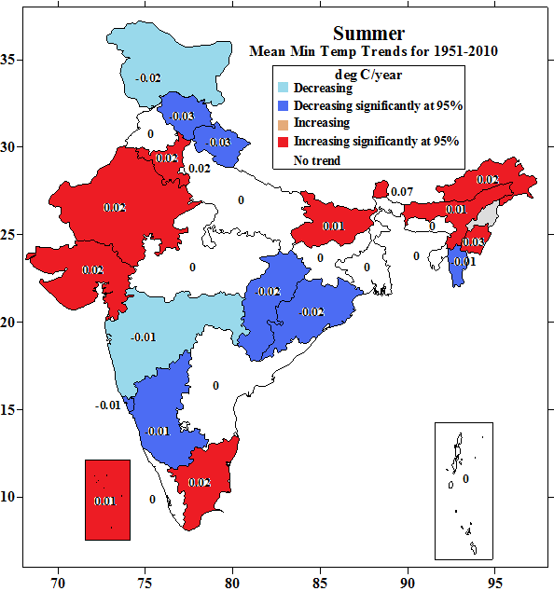
Gestalt Principles of Visual Perception
Grouping:
Law of Similarity

Slide 60
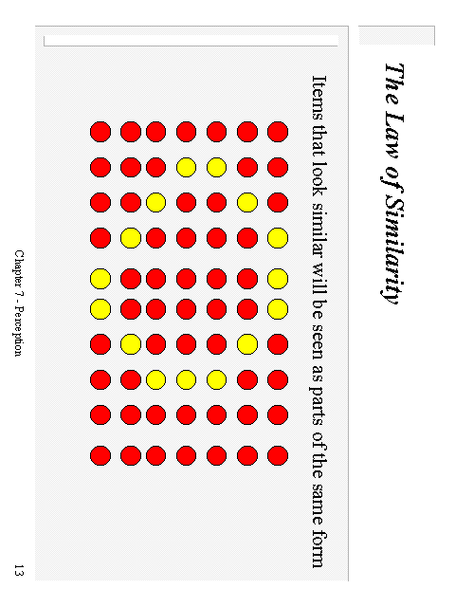
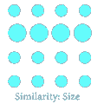

Gestalt Principles of Visual Perception
Grouping: Law of Similarity: Shape, Scale, Color

Slide 61

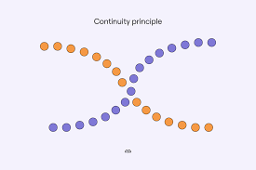
Gestalt Principles of Visual Perception
Law of Good Continuation, or Continuity
Objects arranged in either a straight line or a smooth curve tend to be seen as a unit.

Slide 62


Gestalt Principles of Visual Perception
Law of Closure

Slide 63

Gestalt Principles of Visual Perception
Law of Common Fate:
Explains our tendency to see visually related elements moving together (same speed, direction) as a single, unified group or object

Slide 64

Gestalt Principles of Visual Perception
Goodness of Figure, or the Law of Pragnanz (with meaning)
The word is
TIE

Slide 65

Gestalt Principles of Visual Perception
Figure/Ground relationships
Figure – seen as the foreground
Ground – seen as the background
Contours – “belong” to the figure

Slide 66

Gestalt Principles of Visual Perception
Reversible Figure/Ground
relationship

Slide 67

Gestalt Principles of Visual Perception
Reversible Figure/Ground
Relationship:
Tessellation – interlocking figure/ground
M.C. Escher

Slide 68
Module 1.4
Data Cleaning Using Excel
Essential step as the real world data is often
Inconsistent
Incomplete
Inaccurate
Data cleaning will improve:
Accuracy of Analysis
Enhances visualization quality
In better Decision making
Required for advanced analytics

Slide 69
Excel Functions
Original Data | Name of the Function used | Purpose | Result
Testing of the informarion | proper | Converts into Title case | Testing Of The Informarion
3.10 IFERROR() | clean | Removes unprintable characters | 3.10 IFERROR()
there is a lot of empty space on either side | trim | Removes extra spaces (leading, trailing, and multiple spaces between words). | there is a lot of empty space on either side
this is a text ENterED | upper | Converts text to uppercase. | THIS IS A TEXT ENTERED
This a TEXT Entered in | lower | Converts text to lowerrcase. | this a text entered in

Slide 70
Excel Functions
Original Data | Name of the Function used | Purpose | Result
123 | value | Converts numbers stored as text into numeric format. Fixing calculation errors due to text-formatted numbers. | 123
13-01-2026 | datevalue | Dates are stored as text, so Excel cannot sort or calculate with them. | 46035
entered 0 as year, 4 as month and 3 as day in three different columns | date | Converts numers stored as year, month and day format into one date format | 03-04-1900

